Slide 1
SPARKIT: A Mind Map-Based MAS for Idea Generation Support
6th of May, 2024
EMAS 2024
1 Grad. Sch. Aoyama Gakuin University
2 The University of Tokyo
Masaki Ishizaka¹ Akihito Taya² Yoshito Tobe¹
Notes:
**タイマーをリセットする！
Hello everyone,
and thank you for joining my presentation today.
My name is Masaki Ishizaka,
and I am a master’s student at AGU.
Today, I will discuss our study
“SPARKIT: A Mind Map-Based MAS for Idea Generation Support”.
This study aims to support individual idea generation
by facilitating discussions between user and multiple agents.
[0:27]

Slide 2




Generating Creative Ideas
Introduction
Idea Generation by Individual
Idea Generation through Group Discussion
Quality of Ideas[1]
Diversity
Diversity
Quality of Ideas[1]
Discussion Convergence
Discussion Divergence
Balancing the Quality of Ideas from Individual Thought with the Diversity of Opinions in Group Discussions
Challenge
[1] "A review of brainstorming techniques in higher education", Al-Samarraie, H. et al (2018)
Notes:
Before discussing our approach and findings,
let me briefly explain the context and challenges of this work.
Ideas are needed in many contexts,
such as product development and addressing social challenges.
The process of generating ideas
can generally be divided into two types: individual-based and group-based.
It is often said that
individual idea generation yields higher quality ideas.
However, it tends to limit diversity
due to dependence on personal knowledge.
On the other hand, group-based idea generation
introduces a variety of opinions.
Yet, it is often criticized for
leading to divergent discussions
that can degrade the quality of ideas.
★This study aims to support individual idea generation.
Simultaneously, we seeks to balance idea quality
with the diversity of opinions considered.
[1:28]

Slide 3
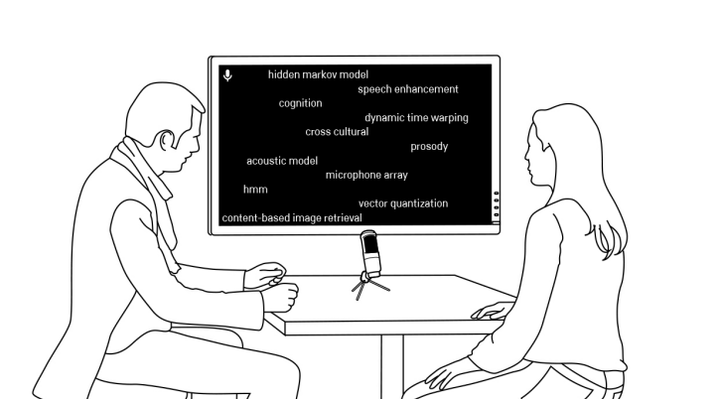
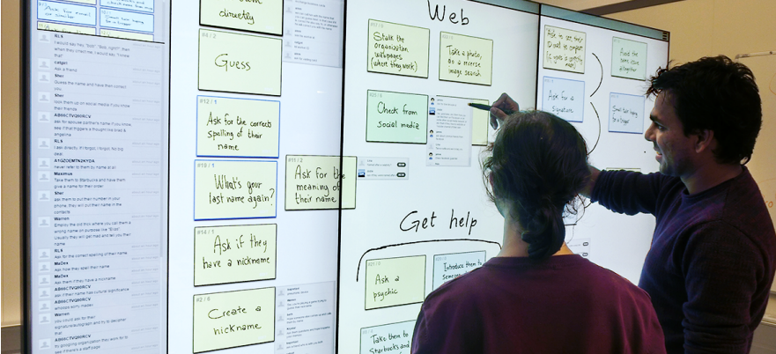
Idea Generation Support Systems
Related Work (1)
Presents Related Information
Based on User Speech[2]
Cloud-Based Approach[3]
Dependent on User Speech
Lacks Support
for Integrating Specific Ideas
[2] "InspirationWall: supporting idea generation through automatic information exploration", Andolina, S. et al (2015) [3] "Crowdboard: augmenting in-person idea generation with real-time crowds", Andolina, S. et al (2017)
Notes:
Several systems have been developed
to address the limited diversity often found in individual idea generation.
★The system called InspirationWall
stimulates user creativity
by presenting keywords related to their utterances.
★However, this feedback depends on the user's speech,
making it difficult for users who do not have specific ideas.
★Utilizing cloud-based methods can minimize dependency on specific user actions.
★However, these systems encounter difficulties
such as diverging of discussions
and insufficient support for integrating the discussions into concrete ideas.
[2:10]

Slide 4
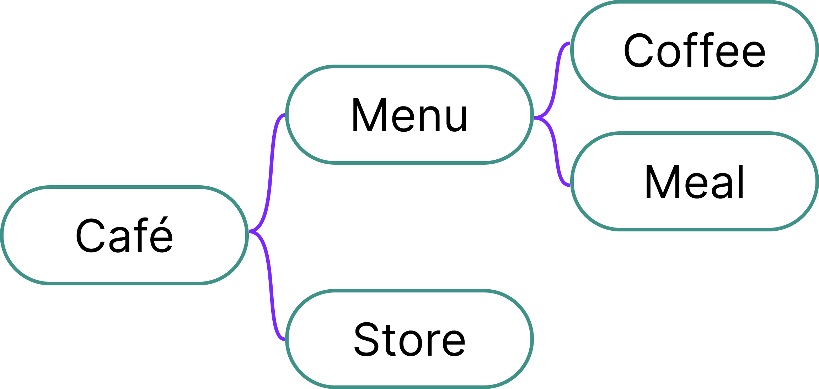
Mind Map[4]
Related Work (2)
Feature
Structuring Thoughts Using Keywords
Related Keywords
Theme
Impact on Idea Generation
Increase in the Quantity
and Quality of Ideas[5]
[4] "The mind map book", Buzan, T. et al (2006) [5] “How do students generate ideas together in scientific creativity tasks through computer-based mind mapping?”, Sun, M. et al (2022)
Notes:
Mind maps are utilized as tools to enhance efficiency
in group discussions and individual ideation.
A mind map places a central theme or keyword
at its core, branching out into related keywords.
By structuring thoughts in this manner,
it is possible to organize ideas systematically.
It is claimed that using mind maps for idea generation
not only increases the quantity
but also improves the quality of ideas.
[2:42]

Slide 5
Characteristics of Creative Ideas
Related Work (3)
Combination of Concepts[6]
Inter-Domain Concepts (Indirect Relationships) [7]
Smart Speaker
Speaker
Internet
Bird
Car Design
Ｘ
Direct
Indirect
Voice Recognition
AI Agent
Fly
Mind Map
Visualizing the relationships between concepts to facilitate combinations[8]
Support is needed to consolidate combinations into specific ideas.
[6] "Technological novelty profile and invention’s future impact", Kim, D. et al (2016) [7] "How AI-supported searches through other perspectives affect ideation outcomes", Wahl, J. et al (2022)
[8] "How do students generate ideas together in scientific creativity tasks through computer-based mind mapping?", Sun, M. et al (2022)
Notes:
To generate creative ideas,
it's effective to combine different concepts.
For instance, by integrating voice recognition
with a combination of speakers and the internet,
we can create an idea of smart speaker.
Additionally, combining concepts
from different domains can also be effective.
For example, by applying the shape of a bird to the design of a car,
we can reduce air resistance of car.
Understanding concept relationships is essential.
★Direct relationships are straightforward, such as birds and flying.
However, it's the combination of indirect relationships that often leads to more creative ideas.
By exploring these less obvious links, we can achieve innovative solutions.
This is why combining concepts from different domains is so effective.
Using mind maps facilitates
the visualization of these concept relationships,
making it easier to combine them.
However, transforming these combinations
into concrete ideas is not straightforward,
which is why support in this process is crucial.
[3:55]

Slide 6



Iterative Idea Generation
Related Work (3)
Iterative Prototyping and Creativity[9]
Associative Fluency and Creativity[10]
Prototyping
Creative people:
Higher associative fluency
Iterative
Feedback
Individual Idea Generation
Iterative prototyping
Single prototyping
>
Receiving Feedback
Iterative Improvement
[9] "The efficacy of prototyping under time constraints", Dow, S. P. et al (2009) [10] "Revisiting Mednick's model on creativity-related differences in associative hierarchies. Evidence for a common path to uncommon thought", Benedek, M. and Neubauer, A. C. (2013)
Notes:
According to existing research,
iterating on ideas can enhance their creativity.
★Iterative means
creating a prototype, receiving feedback, and then revising based on that feedback.
According to Dow et al.,
groups that engaged in iterative processes
demonstrated higher performance compared to those that
created prototypes only once.
Additionally, Benedek et al. suggest that
highly creative individuals exhibit
high fluency in associative thinking.
These studies imply “association” and “iteration”
are important in creative idea generation.
These processes transform the combination of concepts
into more indirect relationships.
However, in individual idea generation,
feedbacks on created ideas are not available.
Moreover, since idea generation relies on individual knowledge,
it can be challenging to iteratively improve ideas.
Therefore, support that encourages users
to generate many associations
and provides feedback on them is necessary.
[05:06]

Slide 7
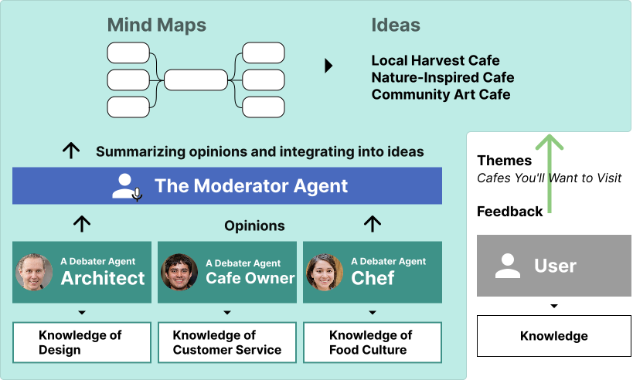
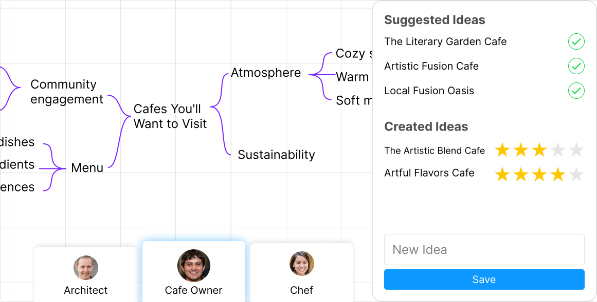
SPARKIT
Method
Mind Map-Based Idea Generation Support System
Debater Agents
Providing
diverse perspectives
based on multiple roles
Lack of diversity
Evaluation of Ideas
A Moderator Agent
Editing a mind map
Integrating discussions
into a mind map
Continuing
to diverge
Notes:
In this research, we propose SPARKIT,
a mind map-based idea generation support system
designed to address the challenges in idea creation.
SPARKIT incorporates two types of agents based on LLMs:
Debater Agents and a Moderator Agent.
★Each DA, having a unique personality like an architect,
presents opinions based on their specific roles.
★This approach addresses the issue of lack of diversity in opinions,
which is common in individual idea generation.
However, presenting opinions from multiple DA simultaneously
can overwhelm users, especially as the number of agents increases.
★To solve this problem, the MA organizes the discussion into a mind map,
making it easier for users to comprehend the content.
★Users can edit and evaluate the generated mind maps,
allowing them to collaboratively generate ideas with the agents.
[06:11]

Slide 8
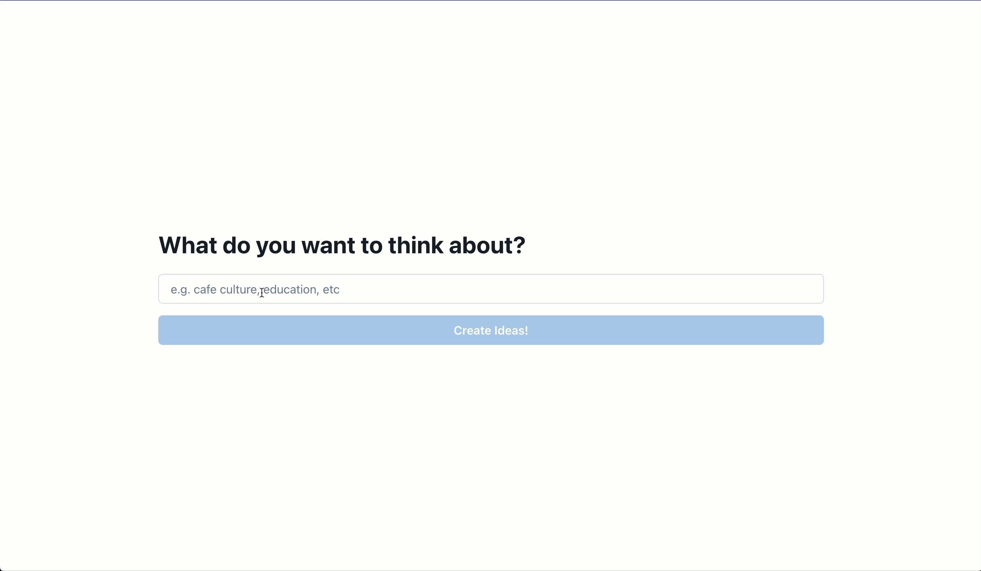
Demo
Notes:
Let me demonstrate how SPARKIT works.
★ First, the user inputs a theme they intend to address.
For example ”planning ideal cafe”.
This triggers the SPARKIT to presents
more specific themes related to the given theme.
Once a theme is selected,
the DAs will generate a mind map to present their opinions.
[06:37]

Slide 9
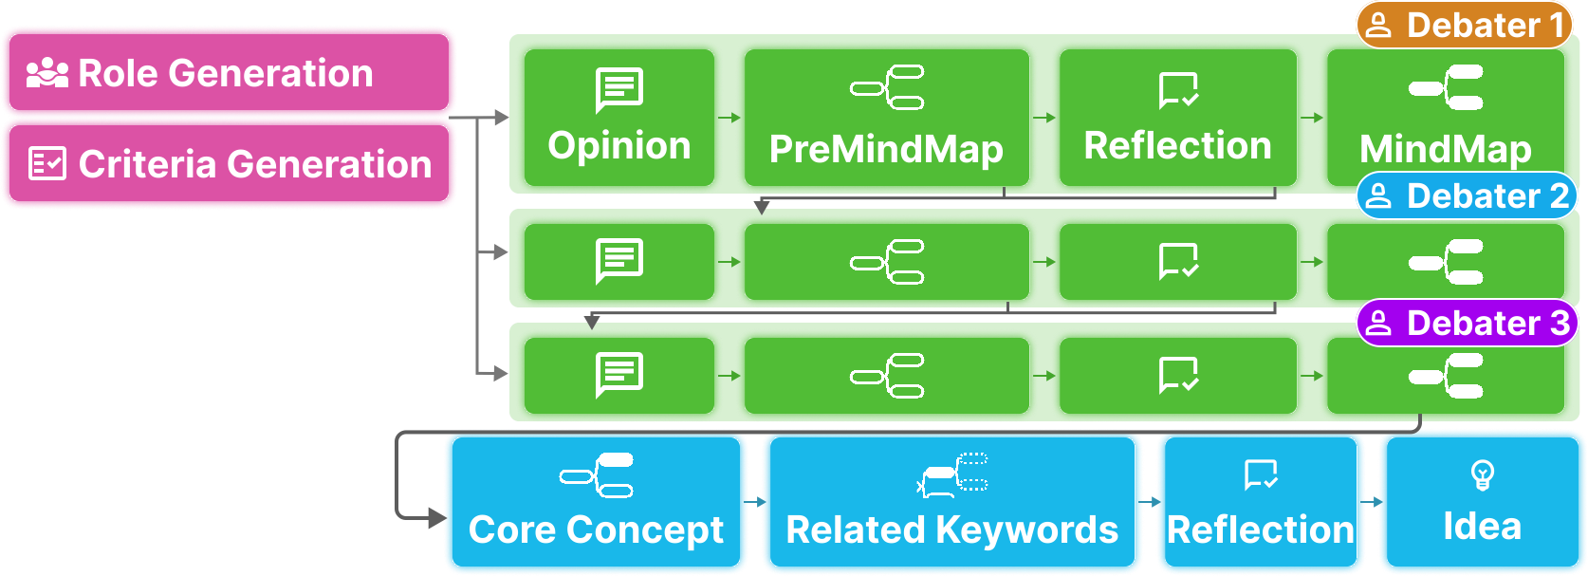
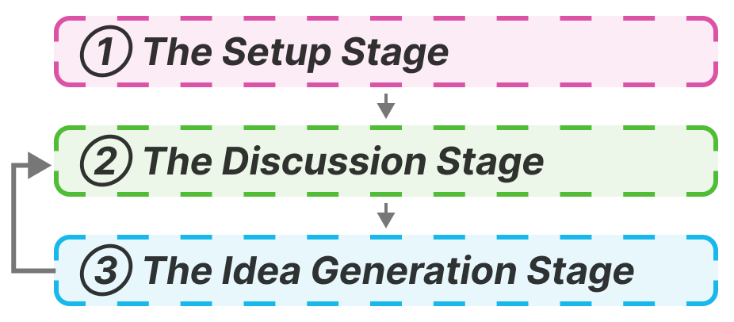
SPARK-flow
Method
Objective
To coordinate multiple agents to generate creative ideas.
Method
To conduct discussions based on mind mapping.
Notes:
In this research, we design a methodology called SPARK-flow
to facilitate multi-agent debates for generating creative ideas.
SPARK-flow consists of three distinct stages:
★1st stage is the Setup Stage: where participants in the debate are determined;
★2nd stage is the Discussion Stage: where each agent presents their opinions;
★ and the final stage is Idea Generation Stage: where ideas are formulated based on the discussions.
By repeating the Discussion Stage,
interaction among multiple agents is facilitated,
thereby enhancing the potential for creative ideas. [07:17]

Slide 10
SPARK-flow：Setup Stage
Method
Background
Participants and policies influence the Creation of Ideas.
Generating 3 roles of Debater Agents
Generating 3 evaluation criteria for assessing opinions
Interior Designer
Culture
Originality
Customer needs
Cafe Owner
In-store
Customer Service
Opinions(e.g.)
1. Design that incorporates local elements
2. Delicious food available (low priority)
Marketer
Outdoor
Understanding of the Market
Multiple roles → Provide diverse perspectives
Retaining opinions
expected to foster creative ideas.
Notes:
In discussions of idea generation,
the participants and their approach significantly influence the quality of ideas.
★In the Setup Stage, SPARK-flow assigns roles to DAs.
★It also sets criteria to prioritize opinions.
These roles and criteria are generated based on the theme
to enhance diverse perspectives.
★For instance, in the theme ”Ideal Cafés,"
roles such as café owners are generated.
Additionally, depending on the role,
these agents gives users different perspectives.
★For instance, "the café owner" might focus on "customer service,"
while "a marketer" might concentrate on "market understanding,"
This approach presents users with perspectives
covering both the ”internal and external” aspects of the café.
MA selects the content presented to the user based on evaluation criteria.
★Let's assume the theme is 'Cafés worth visiting’,
and the DA generate two opinions:1., 2. …
The first opinion, focusing on local design elements,
is rated higher when assessed with 'Culture' as one of the three criteria.
Based on these evaluations, The MA determines the priority of opinions,
Retaining opinions expected to contribute creative ideas.
[09:05]

Slide 11
Discussion Stage
Method
Objective
To facilitate discussions among agents via mind maps.
Challenge
Attempting to include all elements → Oversized mind map
① RawOpinion
② PreMindMap
③ Reflection
Generating opinions
in bullet points.
Extracting common elements
from opinions.
Determining the priority
of elements.
・To create a cafe people, want to...
・Expanding the menu is crucial..
・Innovations in interior and..
# Store Interior Design
- RawOpinion 1 - RawOpinion 2 # Quality of Menu and Ingredients ……
Store Interior Design
Culture [Medium]
Originality [Medium]
Customer needs [High]
Referring to the results of reflection and the mind map
Round
Notes:
During the Discussion Stage, agents engage in debates using mind maps.
However, generating mind maps [directly from the debate content]
can lead to an oversized mind map,
because it attempts to incorporate every topic discussed.
In order to prevent this issue, SPARK-flow takes two steps
before generating the final mind map:
“creating a PreMindMap” and “conducting reflection”.
★Initially, Debater Agents produce bullet-point opinions
based on their roles about the theme,
referred to as RawOpinions.
★Subsequently, these opinions are organized
into a PreMindMap based on common perspectives.
★In the reflection step,
each element is evaluated using specific criteria
to determine its priority for inclusion in the mind map.
The final mind map is then created based on the outcomes of this reflection.
★This entire process is termed a "round,"
and the generated mind maps and reflections in one round
are utilized to enhance subsequent rounds.
[10:23]

Slide 12
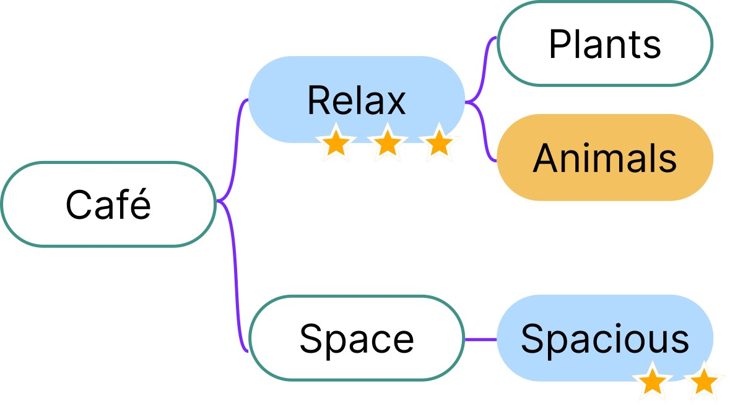
Idea Generation Stage
Method
Objective
Idea Generation Utilizing Mind Map Structures
1
Selecting the Central Concept
Idea
Cat Café
Description
A café where you can
enjoy coffee in a spacious
area while playing with cats.
2
Choosing Keywords
3
Evaluating Keywords
Notes:
In the Idea Generation Stage,
SPARK-flow utilize the structure of mind maps
to facilitate the generation of ideas.
This method focuses on combining concepts
and utilizes the structure of mind maps.
★Initially, SAPRK-flow selects the core concept from the mind map,
which will act as the primary focus for our ideas.
★Subsequently, related keywords are selected.
★These selected keywords are evaluated during the reflection step,
just as they were during the generation of the mind map.
Ideas are then generated based on the results of these evaluations.
[11:08]

Slide 13
Experiments and Results
Notes:
Next, let's proceed to the Experiments and Evaluation.
[11:12]

Slide 14
Experimental and Evaluation Methods
Experiments and Results
SPARK-flow Component Comparison
Comparison with Baseline Methods
Simple (gpt-3.5-turbo)
Referencing opinions of other agents
Utilizing mind maps
Divergence and convergence process
Presence of reflection
Generate creative ideas about “{{ theme }}”.
Objective
Examination of performance degradation and effectiveness of SPARK-flow
Notes:
In experiments, We evaluated
how elements within SPARK-flow contribute to the creativity of ideas.
These elements include
“group discussions”,
“the use of mind maps”,
and “diverging and converging discussions.”
Additionally, we compared SPARK-flow with a baseline method.
In the baseline method, we instructed GPT-3 to "generate creative ideas about theme."
We refer to this method as "Simple.”
By comparing the performance with Simple
we verified any degradation in performance. each time we modified the elements within SPARK-flow,
[11:52]

Slide 15
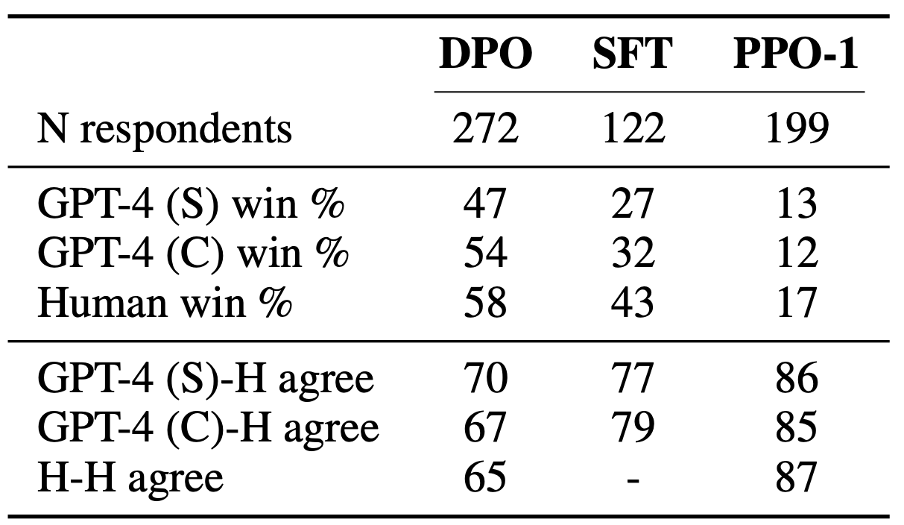




Evaluation of Ideas by GPT-4 (1)
Experiments and Results
Correlation between GPT-4 and Human Evaluation [11]
Similarity
with Human Evaluations
Degree of Agreement
Lower
agreement
Higher
agreement
[11] Direct preference optimization: Your language model is secretly a reward model", Rafailov, Rafael et al (2024)
Notes:
Traditionally, the evaluation of creative ideas
has primarily been conducted by experts,
However, the lack of consistency
[among expert assessments] has posed a significant challenge.
Considering "this" context and the recent "progress" in LLMs,
evaluations using GPT-4 have gained attention.
Rafael et.al. presented two summary texts
to both humans and GPT-4,
asking them to choose the better one.
★The results showed a strong correlation
between the evaluations of humans and GPT-4.
Furthermore, the agreement between human and GPT-4 evaluations
was higher than that between humans alone.
★Especially, the closer the evaluations among humans,
the higher the agreement between human and GPT-4 evaluations. [12:49]

Slide 16
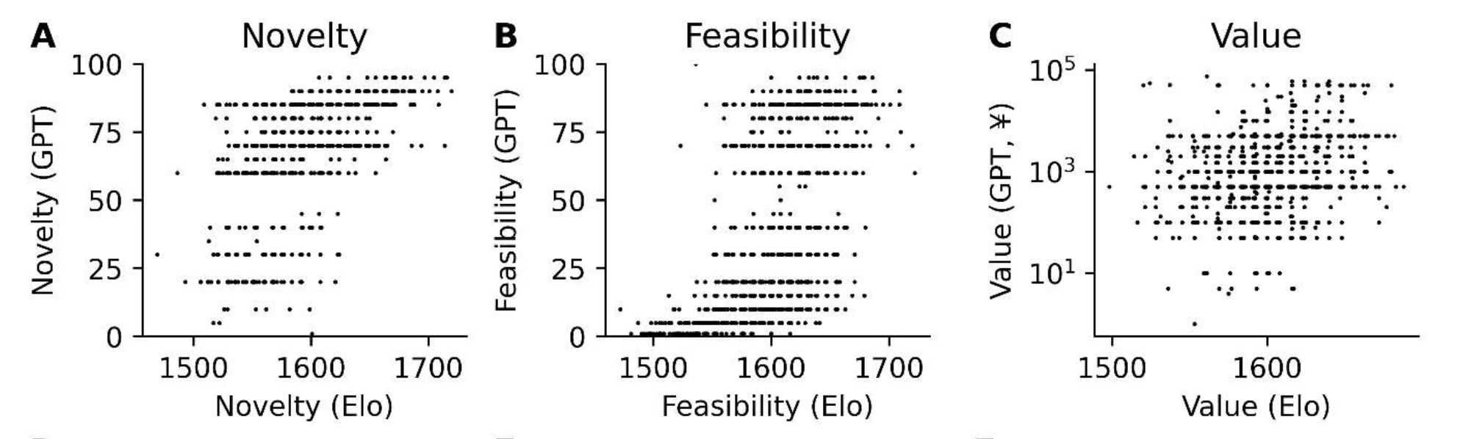
Evaluation of Ideas by GPT-4 (2)
Experiments and Results
Evaluation of Ideas[12]
Correlation with human ratings in terms of novelty and feasibility
[12] "Assessing Novelty, Feasibility, and Value of Creative Ideas with an Unsupervised Approach Using GPT-4", Kern, F. B. et al (2023)
Notes:
Experiments applying GPT-4 for idea evaluation
have demonstrated that it can provide assessments correlated with human judgments
★in terms of novelty and feasibility.
Based on these findings,
this study employs GPT-4 to evaluate ideas. [13:11]

Slide 17
Win Rate: Comparing Two Methods
Experiments and Results
Evaluation by GPT-4
Win Rate
Preferred : Idea B
Reason：Idea B is original but less feasible. Conversely Idea A is…
Idea 1A vs Idea 1B → A
Idea 2A vs Idea 2B → A
Idea 3A vs Idea 3B → B
Win rate of Method A：66%
T-test
60% Theme 1
70% Theme 2
65% Theme 50
…
Win Rate = 50%
(Randomly Selected)
[8] "Assessing Novelty, Feasibility, and Value of Creative Ideas with an Unsupervised Approach Using GPT-4", Kern, Felix Benjamin et al (2023)
Notes:
Let me explain the method for evaluating ideas using GPT-4.
Two ideas generated using different methods
will be presented through prompts to GPT-4.
GPT-4 will be asked to select the more creative idea
and provide a reason for their choice.
According to Kern et al., generating reasons
for evaluations improves performance of evaluation.
★Based on these comparison results,
we will calculate the win rate for each method.
★During evaluation, 3-5 ideas will be generated for each method for 30-50 themes.
Assuming a 50% win rate for random selection,
we analyzed whether the win rate
significantly exceeded 50% using t-tests.
Based on these results,
we compared the effectiveness of the methods.
Additionally, by counting the number of themes
where the win rate exceeded 50%,
we verified how each method depends on the theme.
[14:19]

Slide 18
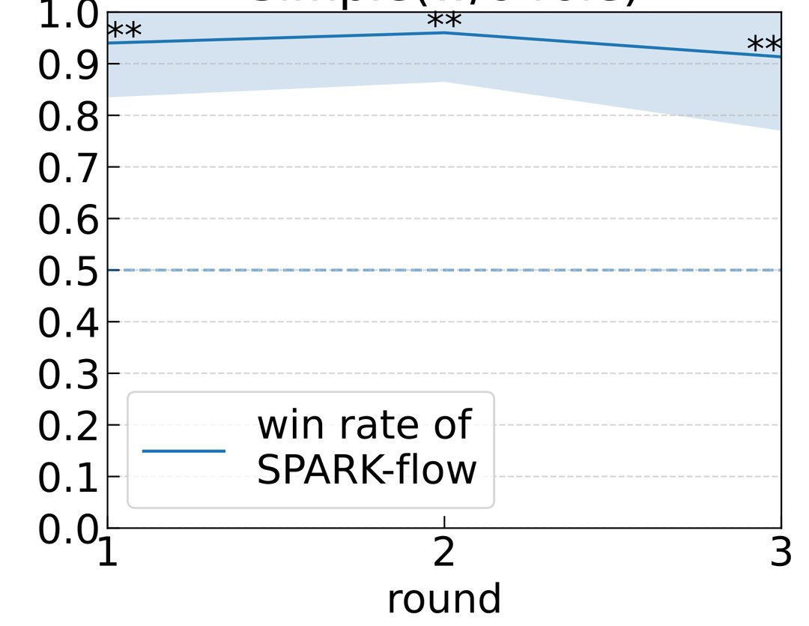
Comparison Between Simple and SPARK-flow
Experiments and Results
# of Comparisons | 450
# of Themes | 50
Win rate for SPARK-flow | 91.3±14.3% ( p < 0.01 )
# of themes win rate > 50% | 48 ( 96.7% )
Contribution to Idea Creativity
Low Dependency on Themes
The multi-agent discussions formed by SPARK-flow impact the creativity of ideas.
SPARK-flow can generate creative ideas across a diverse range of themes
Notes:
When comparing SPARK-flow and Simple,
★it was found that SPARK-flow has a significant advantage
with an average win rate of 91.3%.
★Additionally, in 96% of the themes,
covering 48 themes,
win rate of SPARK-flow exceeded 50%.
These results suggest that SPARK-flow
can generate more creative ideas than simpler methods.
★Moreover, it demonstrates that SPARK-flow can be universally applied
across various themes without relying on specific dependencies.
[14:57]

Slide 19

Individual Thinking vs. Group Thinking
Experiments and Results
Existing Research[13]
Nominal
>
Interactive Buildup
 | w/ role
# of comparisons | 450
# of themes | 50
Win rate of Nominal | 40.7 ±27.7% (p < 0.05)
# of themes （win rate > 50%） | 9 ( 32.0% )
w/o role
279
31
64.5 ± 31.6% (p < 0.05)
22 ( 71.0% )
Nominal
Without referencing other‘s opinions
Interactive Buildup
With Referencing other’s opinions
<
>
[13] "Idea generation and the quality of the best idea", Girotra, K. et al (2010)
Notes:
According to Girotra et al.,
groups that initially think individually before discussing as a group
generate more creative ideas
compared to groups that discuss collectively from the start.
This experiment investigates
whether the same phenomenon occurs
among agents during discussions.
Groups that think individually before discussion are referred to as "Nominal groups,"
while those that engage in collective discussion from the start are called "Interactive Buildup.”
★In the experiment, Debater Agents in the Interactive Buildup
reference others' opinions during idea generation,
whereas those in the Nominal Group do not.
The results showed that the Nominal Group
had a win rate of 40.7%,
which was lower than the Interactive Buildup.
★However, when Debater Agents were not assigned roles,
the win rate of Nominal Group increased to 64.5%,
reflecting the results found in Girotra's experiment.
[16:04]

Slide 20
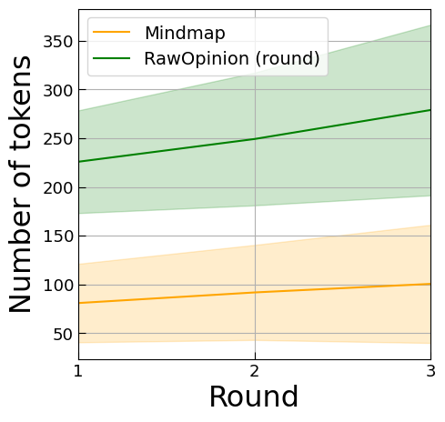
Exploration of Differences Based on the Presence of Roles
Experiments and Results
Factors Analysis
An increase of approximately 30 tokens per round
Feedback in response to other’s opinions
Impact on Creativity of Ideas
w/o role：General feedback
w/ role：Biased feedback
Feedback based on role-specific knowledge contributes to the creativity of ideas
Notes:
To explore why the presence or absence of roles affects creativity in ideas,
we analyze the progression of # of token per round in the Interactive Buildup.
★As shown in the green on the left diagram,
it's observed that the # of tokens for RawOpinion increase with each round.
This increase in tokens is hypothesized to result from
presenting opinions based on viewpoints of others.
After reviewing the outcomes,
we observed that DA added to others' opinions
and improved them.
★In scenarios without assigned roles,
The feedback tends to be more general.
In contrast, with roles, feedback leverages
the specific knowledge associated with those roles.
★This interaction "based on role-specific knowledge"
among agents is considered to have influenced the creativity of the ideas.
[17:05]

Slide 21
Divergence and Convergence in Discussions (1)
Experiments and Results
Existing research[14]
Repeating divergence and convergence
>
Divergence only
Divergence
Convergence
Debater Agents
generate opinions.
Moderator Agent
generates a mind map.
refer to mind map after convergence
Divergence only
⇒ Does not generate mind maps.
Idea generation
from RawOpinion
[14] "Enhancing user creativity: Semantic measures for idea generation", Georgiev, G. V. et al (2018)
Notes:
According to existing research,
groups that alternate between divergence and convergence
tend to generate more creative ideas than groups that only diverge.
In this study, the action of expressing opinions by DAs is considered divergence,
while the action of summarizing them into a mind map by the MA is considered convergence.
We aim to verify whether the nature of the debate
between agents and humans aligns.
★To ensure consistency in experimental conditions,
idea generation will be done from RawOpinion using either method
Because no mind map is created when divergence is repeated.
[17:52]

Slide 22
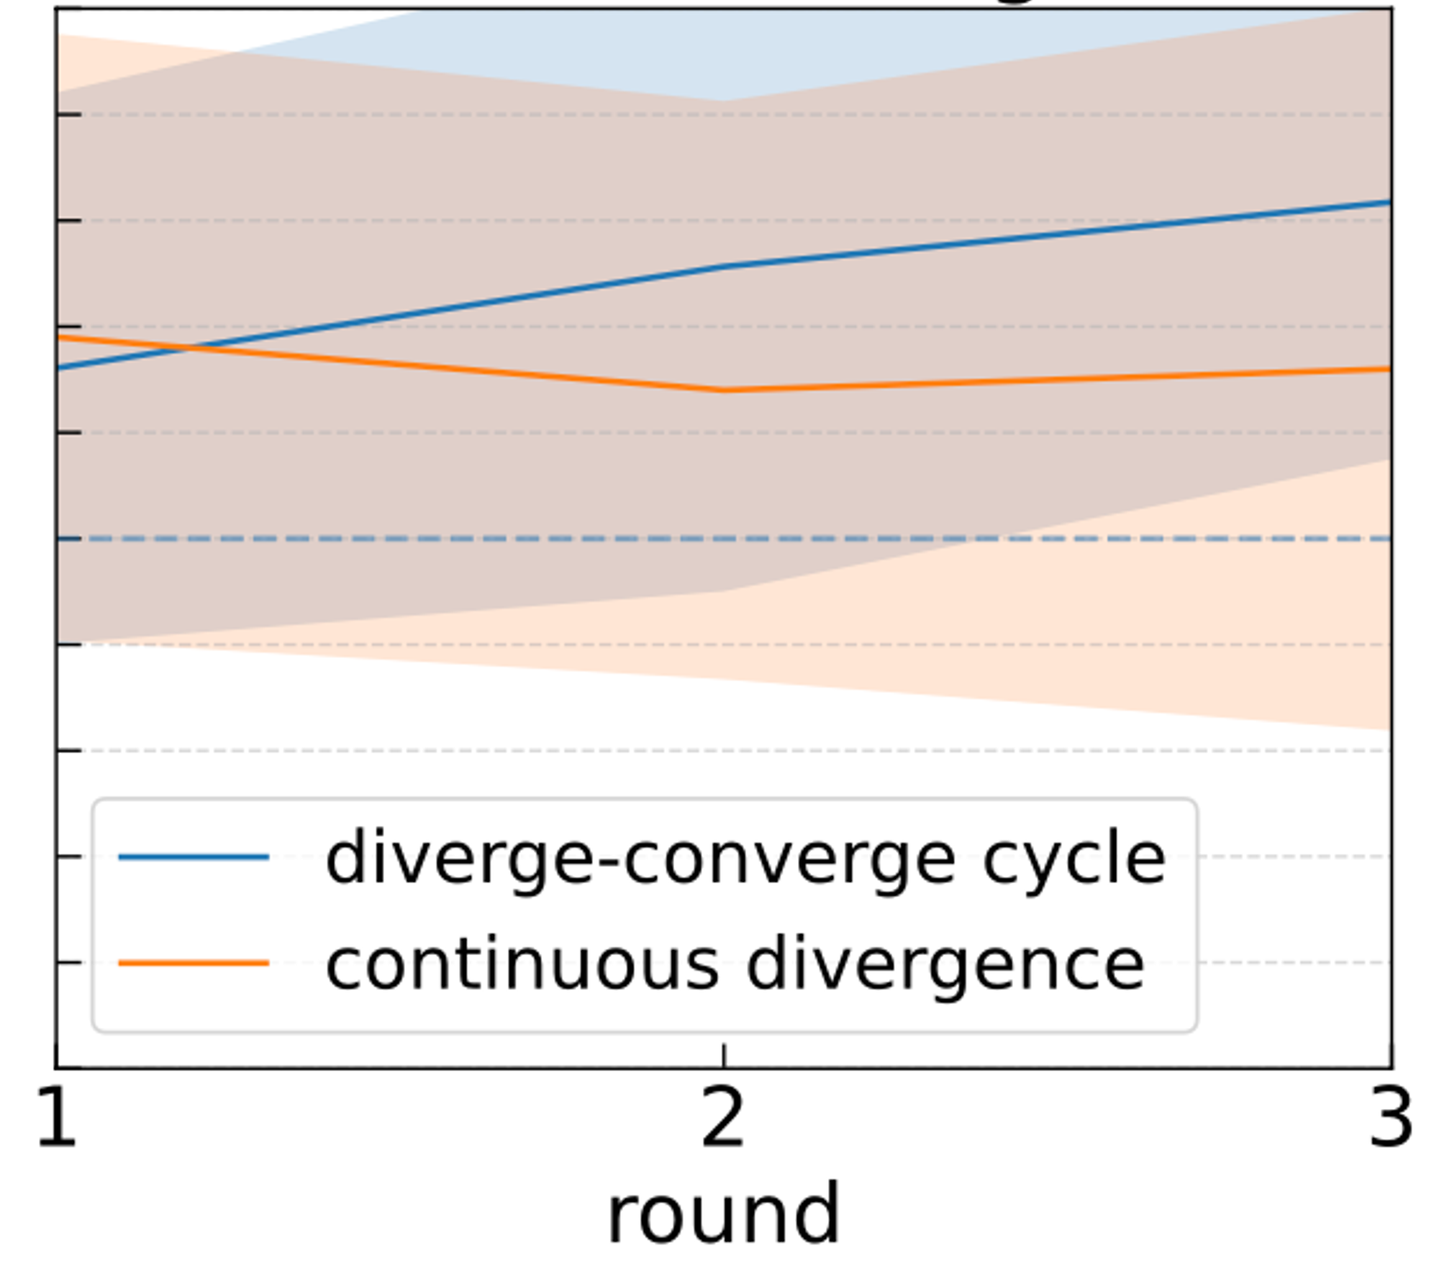

Divergence and Convergence in Discussions (2)
Experiments and Results
# of comparisons | 450
# of themes | 50
Win rate for divergence ↔ convergence | 60±27.5% ( p < 0.05 )
# of themes(win rate >50%) | 33 (66.0% )
Divergence and Convergence
Contribute to the creativity of ideas
Performance
Notes:
The results of the experiment indicated that
groups that alternate between divergence and convergence
generate more creative ideas.
★However, when compared to the Simple method,
the performance is degraded compared to the original SPARK-flow.
[18:09]

Slide 23
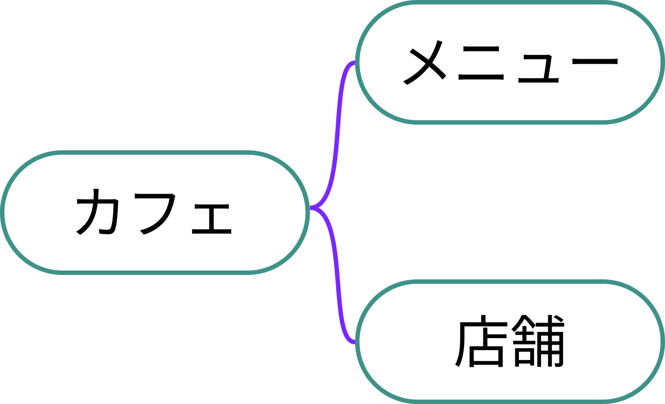
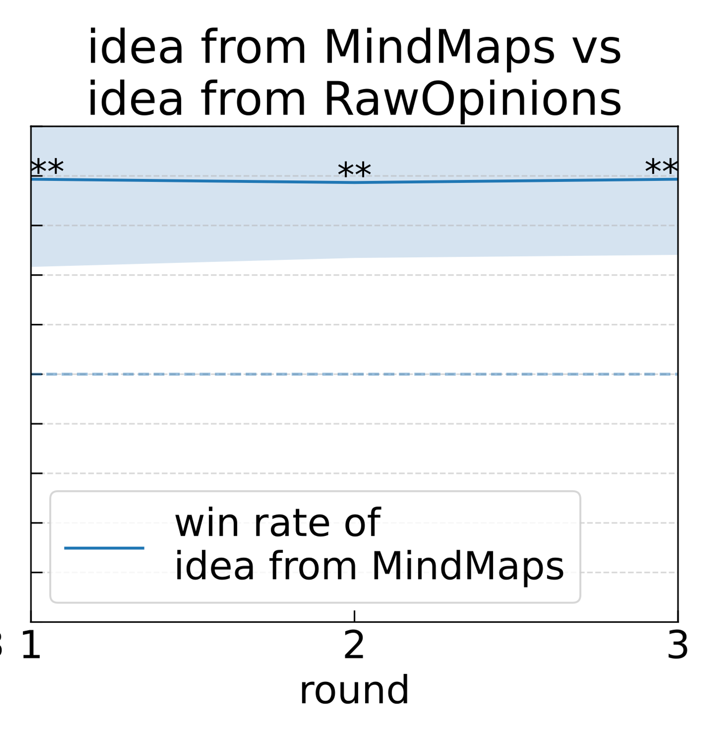
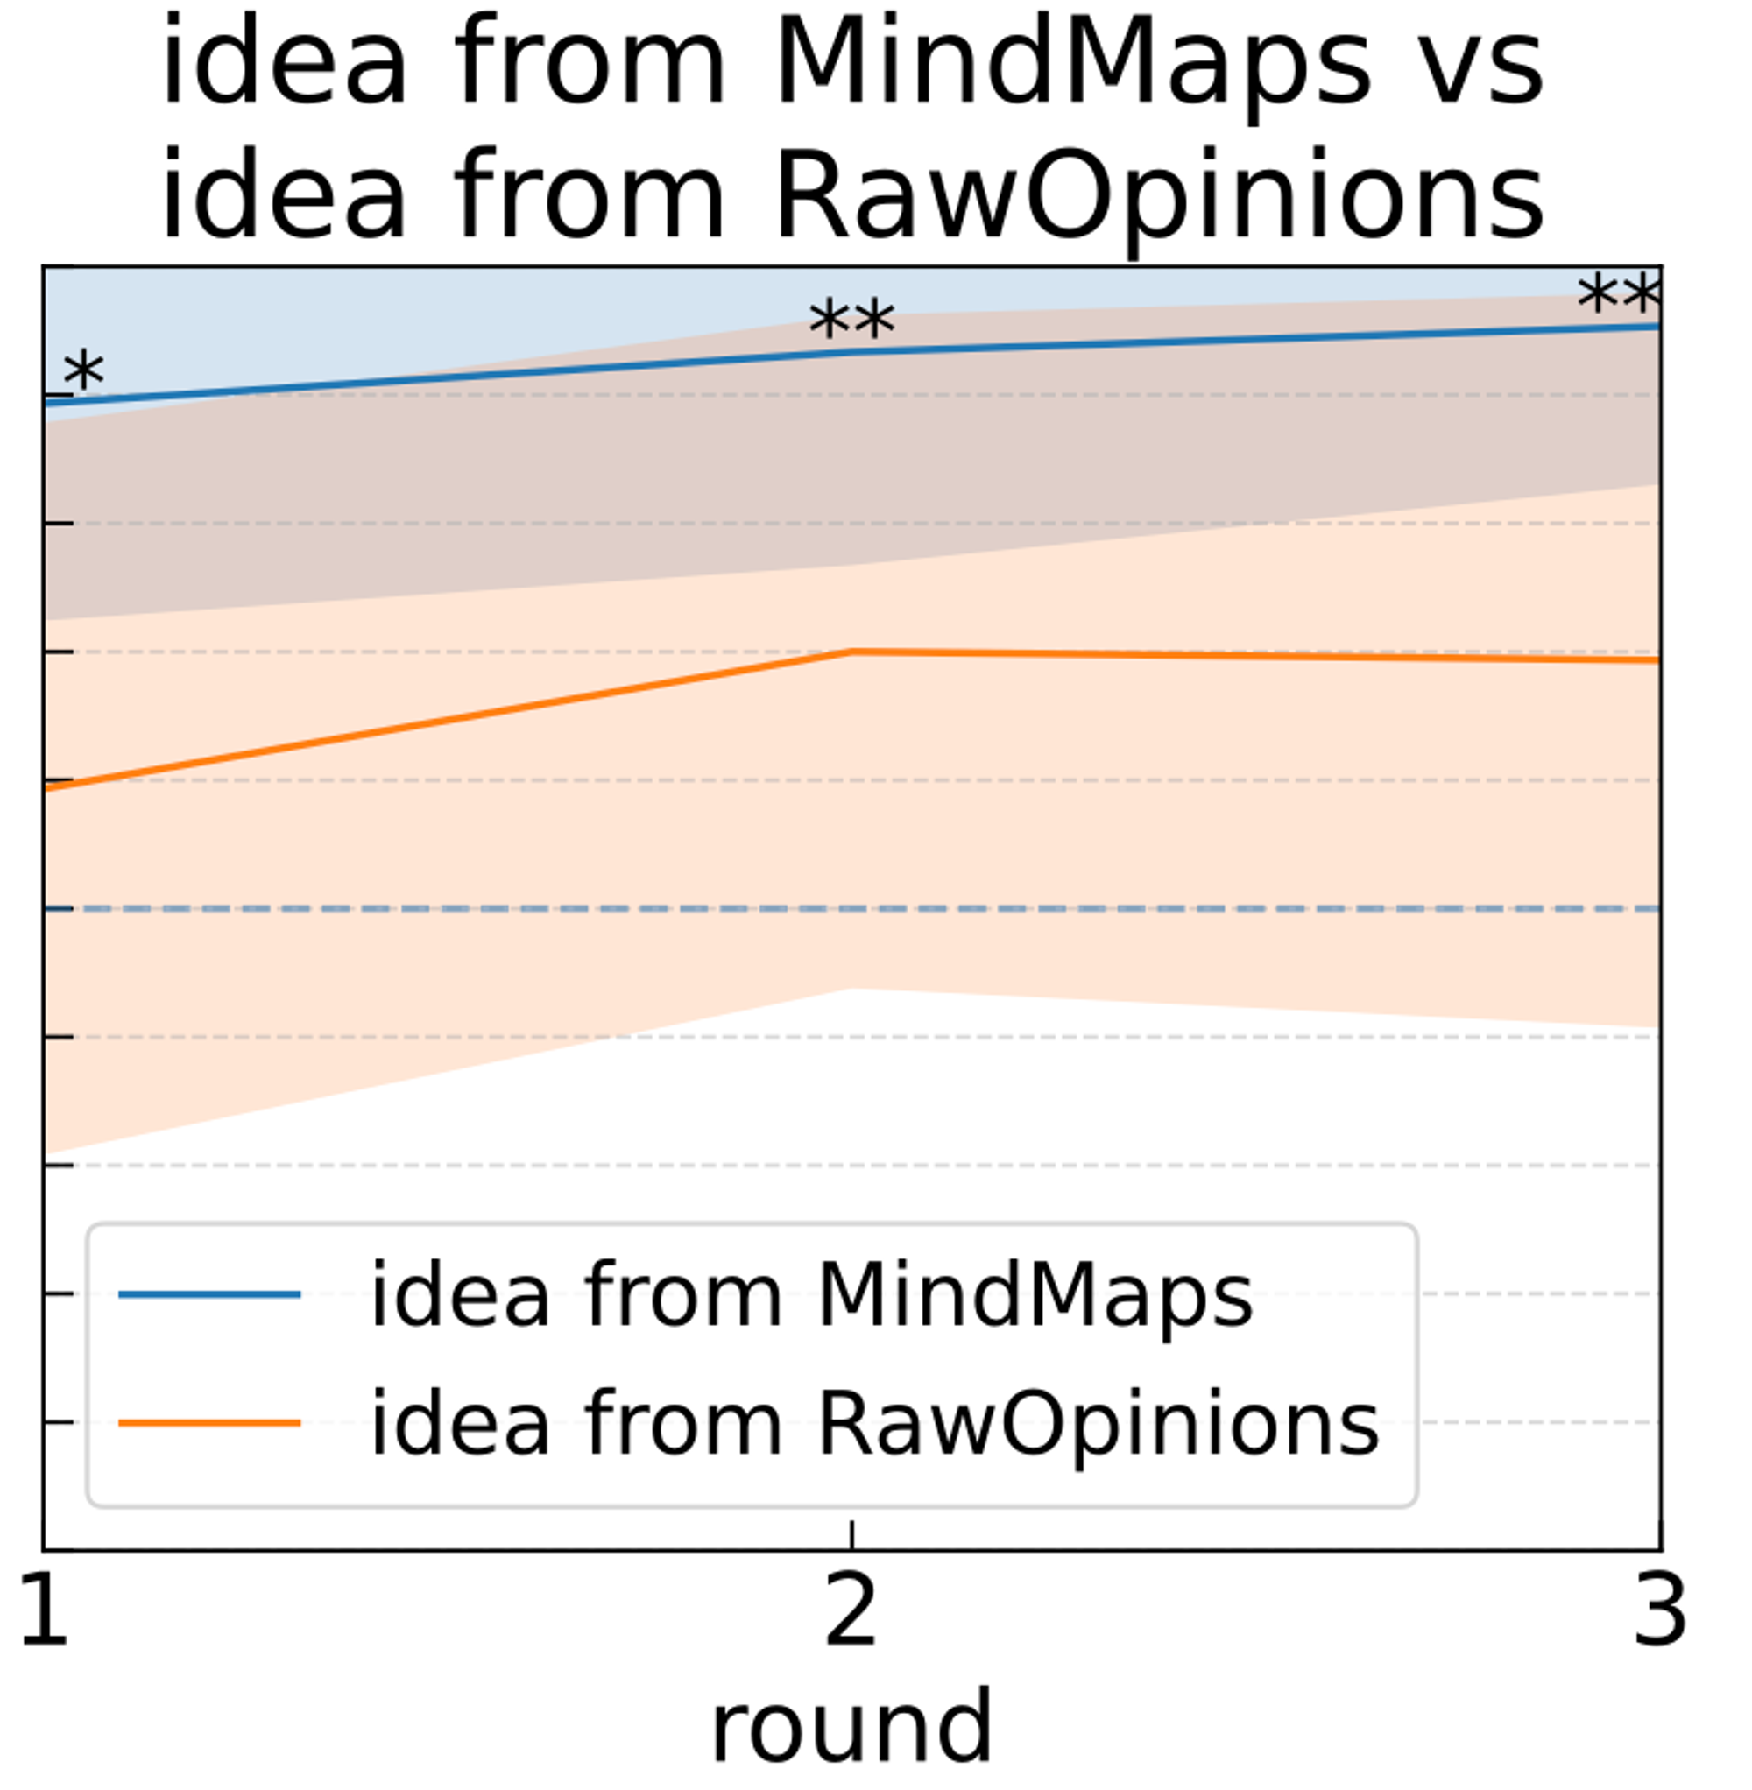
Idea Generation Based on Mind Maps
Experiments and Results
Comparative Methods
Hypothesis
Mind maps facilitate the understanding of relationships between concepts
Pleasant atmospheres and interiors…
Fresh ingredients and specialty…
Local community activities…
Testing if structures illustrate relationships between concepts
RawOpinion
MindMap
# of comparisons | 450
# of themes | 30
Win rate for MindMap | 89.3±15.3% ( p < 0.01 )
# of themes (win rate >50%) | 29 ( 96.7% )
Notes:
In the previous experiment comparing divergence and convergence,
we conducted idea generation
using RawOpinion instead of from a mind map
to align the conditions.
As a result, a degradation of performance in idea generation was observed.
In this experiment, we compared the idea generation process
using mind maps with RawOpinion.
The results show that using mind maps results in
a significantly higher win rate of 89%,
suggesting that mind maps contribute to the creativity of ideas.
★Furthermore, compared to the baseline method,
the variance in win rates was smaller when using MMs,
indicating that utilization of MM consistently produce ideas with creativity.
★This can be attributed to the structure of MMs,
which facilitates the combination of concepts
by utilizing the relationships between them.
★To validate this point,
we analyze how the structure of the MMs represents
the relationships between concepts.
[19:21]

Slide 24
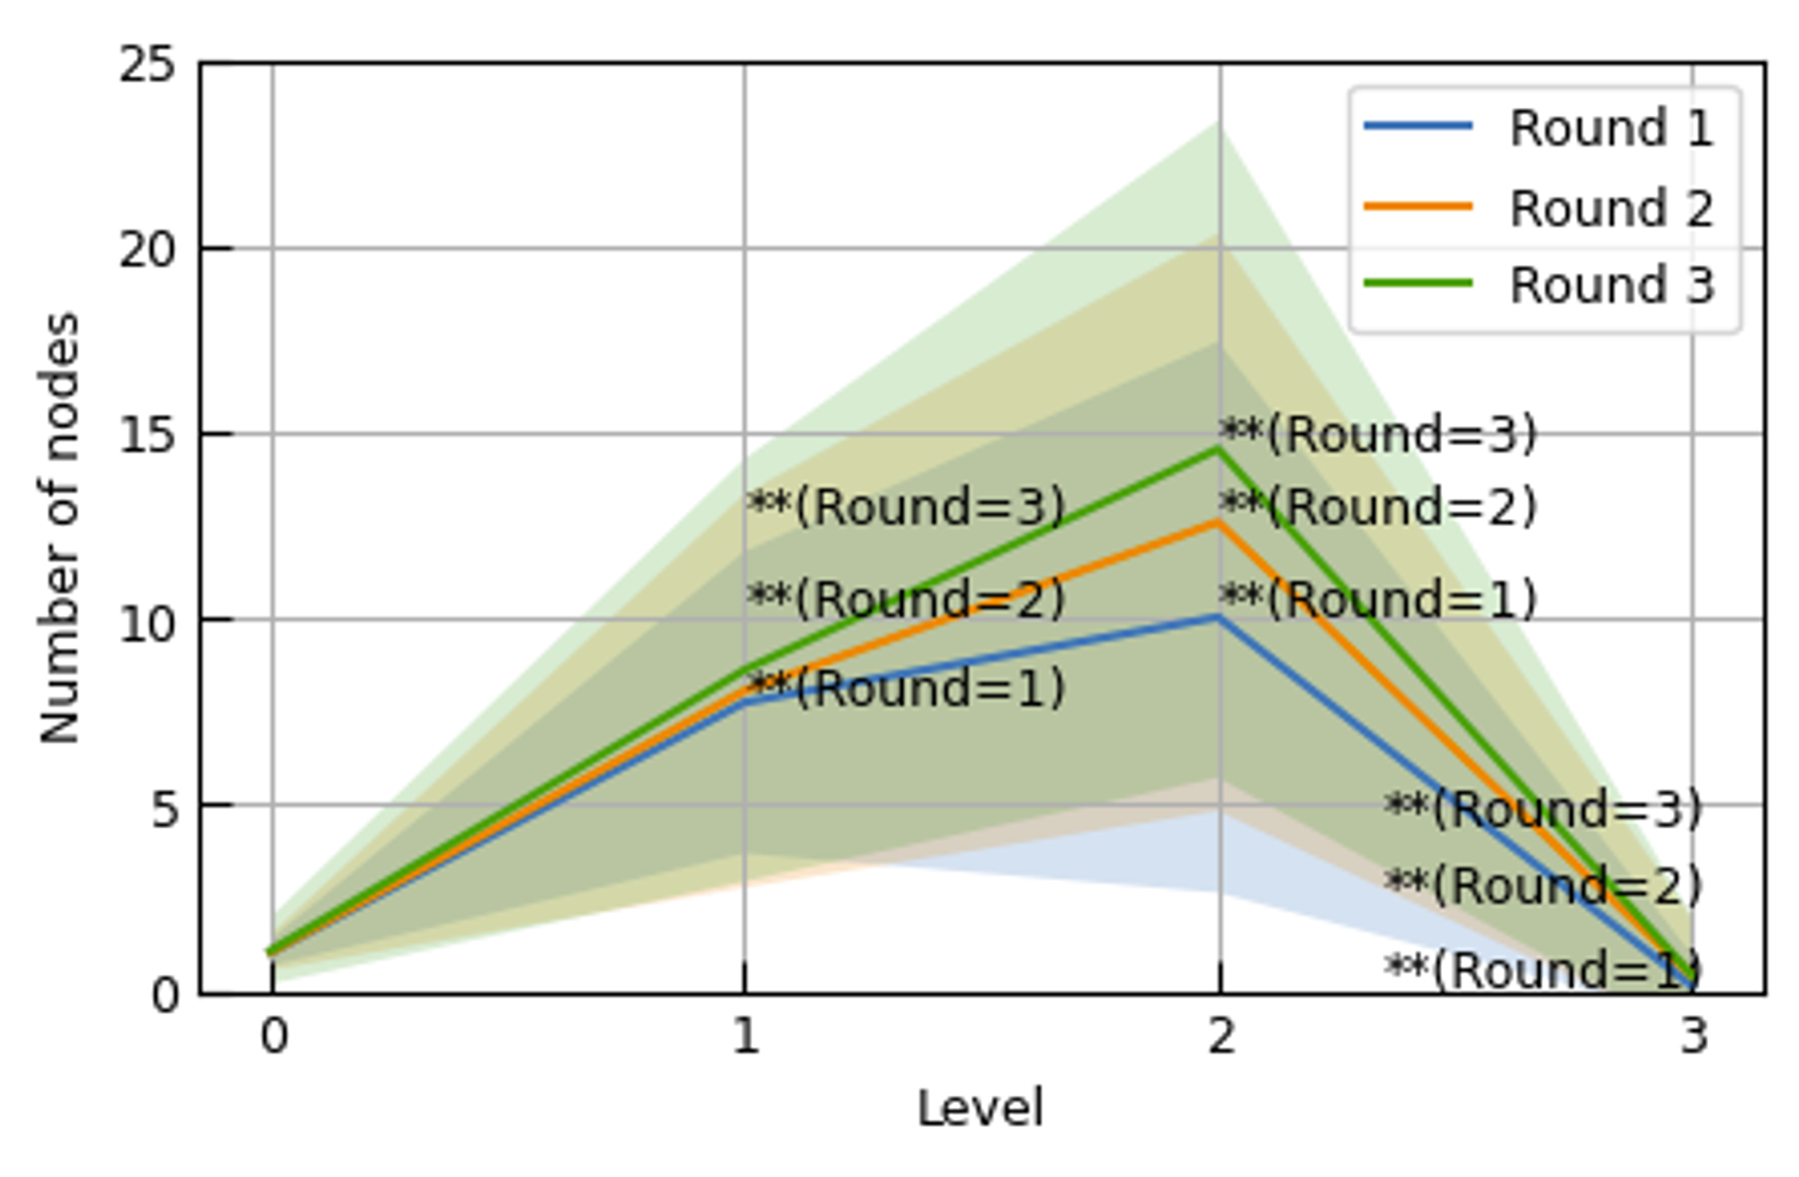
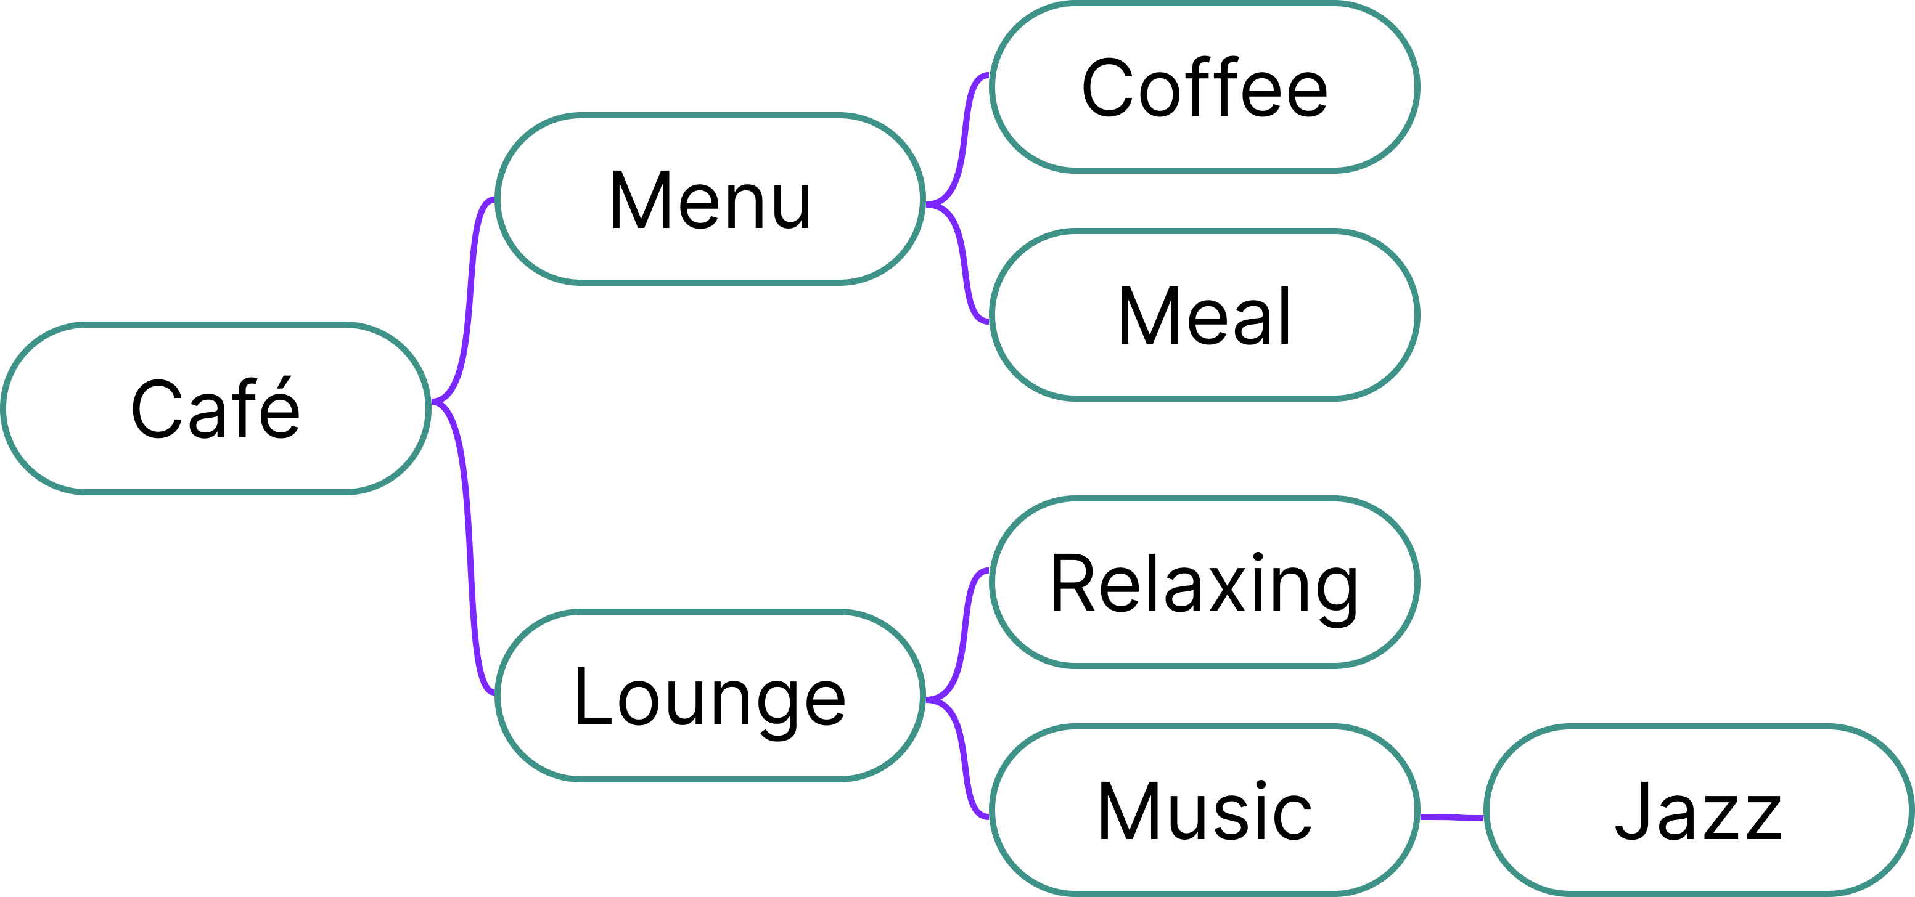
The structure of Mind Maps
Experiments and Results
Method
Analyzing 900 mind maps generated with SPARK-flow.
Level=0
Notes:
We analyzed 900 mind maps generated by SPARK-flow.
Let me define the root node of the mind map as Level=0.
The distribution of nodes in the mind map
★showed that the maximum number of nodes was at Level=2,
★and there were very few nodes at Level=3.
This indicates that the mind maps generated by SPARK-flow
are like the one shown in the figure.
[19:47]

Slide 25

Preserving the Structure of Mind Maps
Experiments and Results
Sim( , )
Sim( , )
Sim( , )
max
＝ Average: 0.99
Round 1
Round 2
Moderator Agent
Keep the content of Level 1 nodes unchanged
Maintains the original structure of the mind map
Notes:
We compared the embedding vectors of Level 1 nodes across rounds.
The cosine similarity between the most similar nodes averaged 0.99.
It was also observed that the content of the Level 1 nodes
remained consistent throughout the rounds.
This consistency can be attributed to the
strategy employed by the MA,
★ which involves using previous mind maps
to maintain the structure of Level 1 nodes.
The experiments suggest that
this method helps maintain the quality of ideas across rounds.
★ This approach offers the advantage of providing users
with organized information that remains relatively unchanged,
making it easier to grasp.
[20:34]

Slide 26
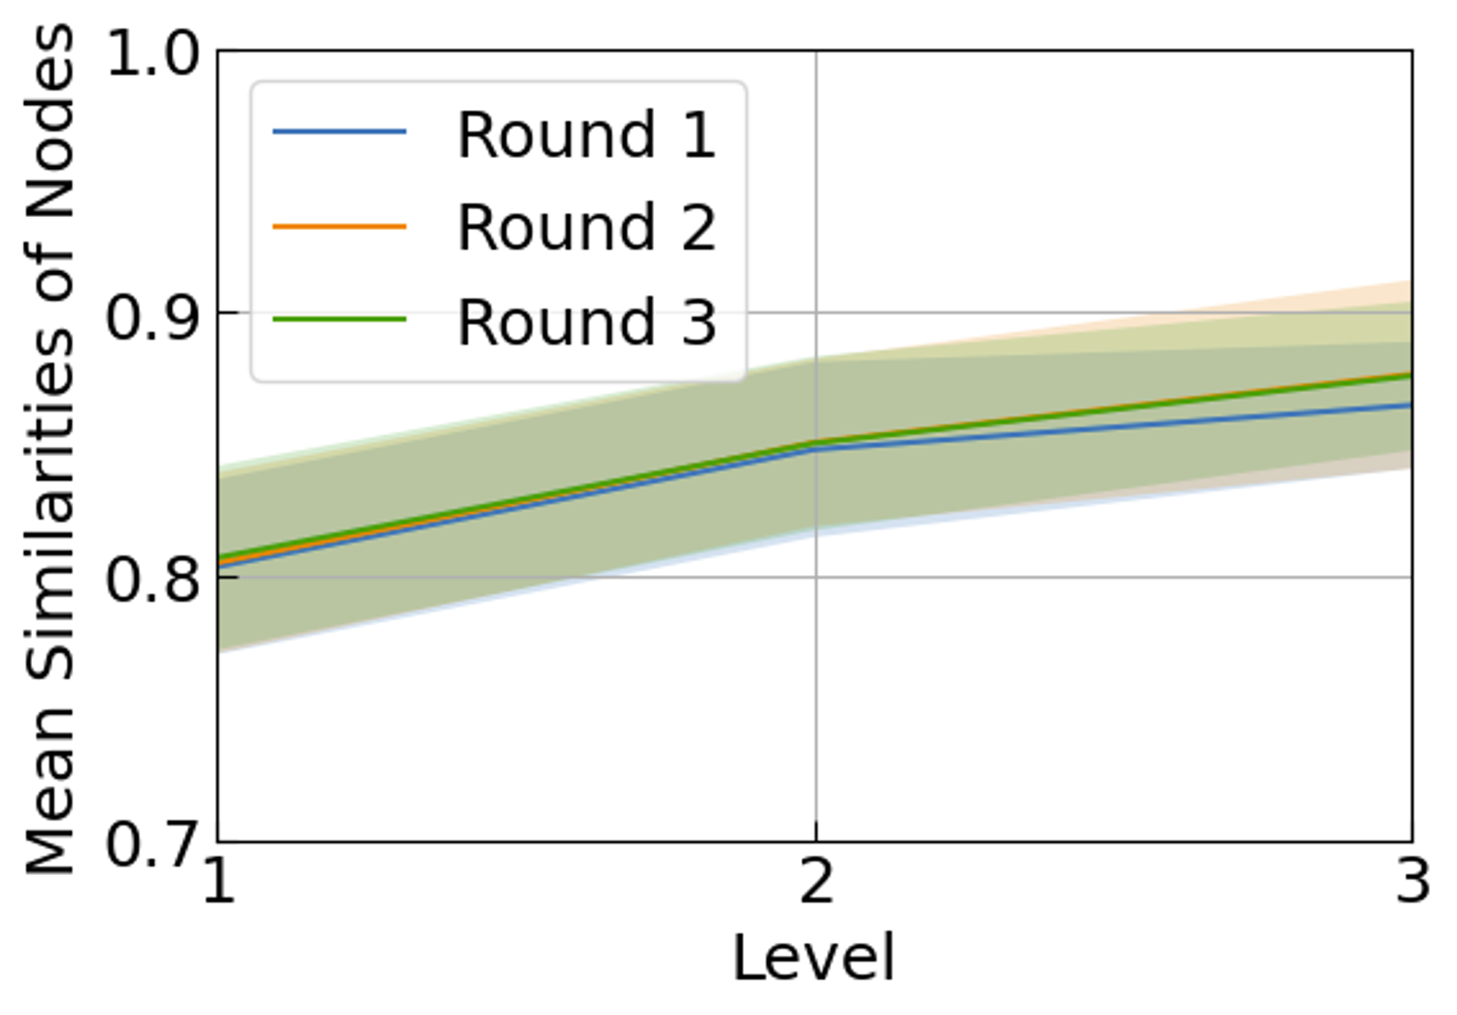
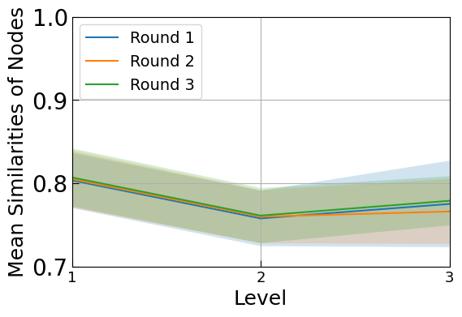
Analysis of Mind Maps Structures and Conceptual Relationships
Experiments and Results
Sim Between Nodes
Comparing cosine similarity of embedding vectors.
Combinations of Nodes with the Same Parent Node
closely related concepts
Combinations of Nodes with Different Parent Nodes
Nodes with the Same Parent Node
Nodes with Different Parent Nodes
distantly related concepts.
High similarity between nodes.
Low similarity between nodes.
Notes:
In this analysis, we examine the relationship
between the structure of a mind map
and the similarity between nodes.
To calculate the similarity between nodes,
we obtained "text embedding vectors" for each node
using the Universal Sentence Encoder,
and then compared the cos similarity of these embedding vectors.
★When focusing on "parent nodes", the similarity
increases at higher levels of "same parent" nodes,
and decreases among nodes with different parents.
★This suggests that combinations of nodes
with the same "parent node" represent "similar concepts",
while those with different parent nodes combine distant concepts.
The structural and conceptual relationships
within these MMs likely contribute to creative idea generation.
[21:24]

Slide 27
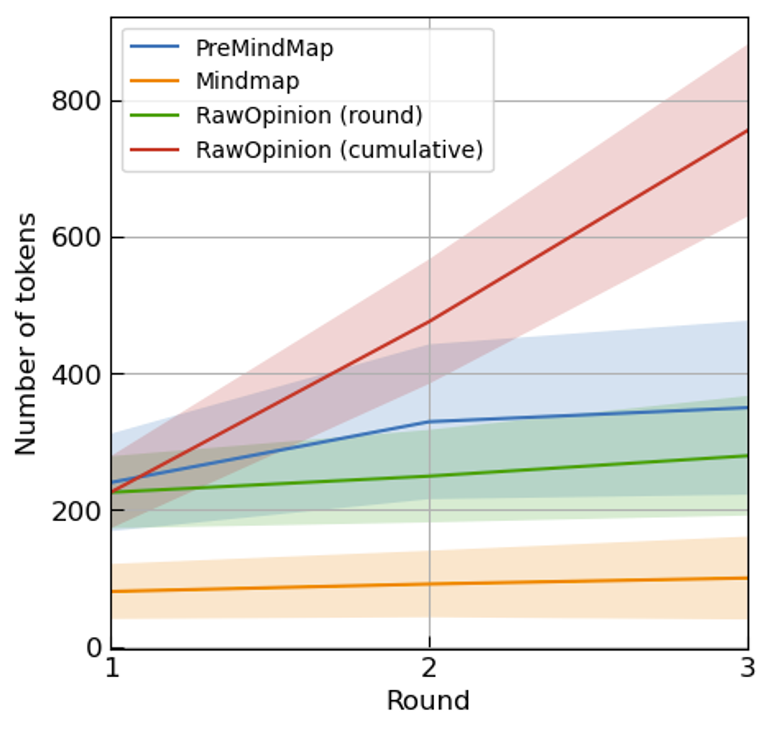
Reducing User Cognitive Load through Mind Map Presentations (1)
Experiments and Results
Method
Analyzing based on the number of tokens and concepts included
Number of Tokens
Keeping the increase
in information content in check
RawOpinion:
Increment of 200-300 tokens / round Total: 800 tokens
Mind map:
Increment of 10 tokens / round Total: 80 tokens
Notes:
We examine how mind maps reduce users' cognitive load,
looking at more than their structure.
Specifically, we analyze the # of tokens and nouns
to assess how many different concepts are present.
From the token perspective,
RawOpinion consists of 200 tokens,
while the mind map can be kept to around 80 tokens.
★Additionally, in the case of RawOpinion
trying to grasp all opinions would result in
an increase of 200-300 tokens per round,
reaching approximately 800 tokens in the third round.
★In contrast, the mind map
keeps the increase to about 10 tokens per round,
even as the number of rounds increases.
[22:25]

Slide 28
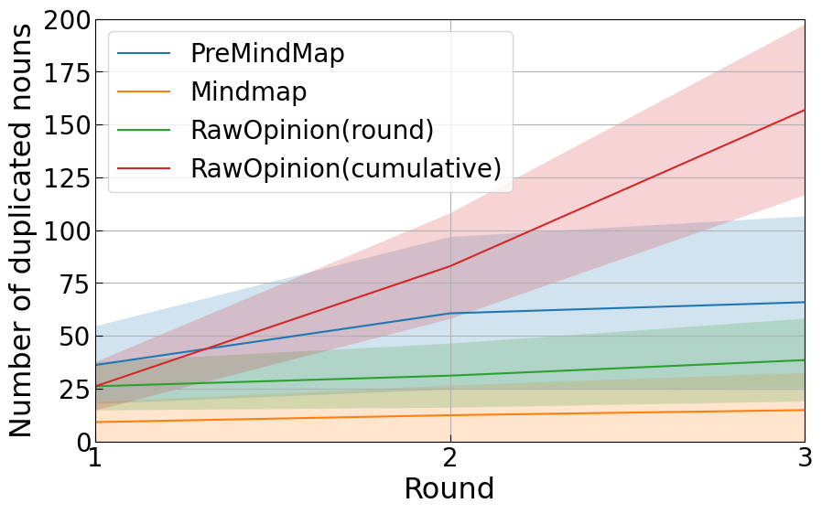
Reducing User Cognitive Load through Mind Map Presentations (2)
Experiments and Results
Method
Analyzing based on the number of tokens and concepts included
Number of Duplicate Nouns
Removing duplicate concepts
to organize information
RawOpinion:
More duplicate nouns
Mind map: Fewer duplicate nouns
Notes:
Furthermore, when examining the overlap of nouns between rounds,
the mind map has fewer overlaps compared to RawOpinion.
This suggests that the mind map controls
the rapid increase in token count by removing overlaps.
[22:42]

Slide 29
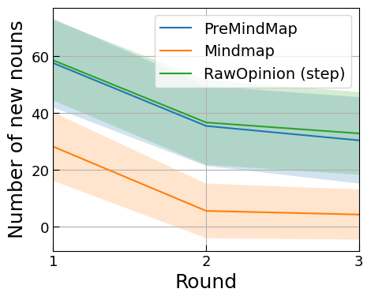
Reducing User Cognitive Load through Mind Map Presentations (3)
Experiments and Results
Method
Analyzing based on the number of tokens and concepts included
Number of Newly Added Nouns
Introducing new concepts
moderately to maintain diversity
Notes:
However, the mind map [may] fail to include new concepts
present in RawOpinion to control the token count increase.
Therefore, analyzing the # of nouns
that did not appear until the previous round
reveals a proportional relationship between RawOpinion and MindMap.
This indicates that eliminating duplicates from RawOpinion
and choosing key elements in the reflection phase
leads to the addition of new concepts.
[23:15]

Slide 30
Future Work
Reinforcement Learning for Agent Interaction
Enhancing agent interactions to foster creativity through reinforcement learning.
Graph Neural Networks for Opinion Referencing
Defining agent relationships as a graph
GNNs to learn opinion referencing and interactions.
User Evaluation of SPARKIT
Conducting research to examine how SPARKIT influences the creativity of user ideas.
Notes:
In our future work, we are considering
enhancing the interaction between agents
using RL to generate more creative ideas.
We plan to {{explicitly}} define the relationships between debater agents as a graph
and utilize GNNs to learn about opinions, references, and interactions. Additionally, we will conduct user evaluations of SPARKIT.
This analysis will include studying the actual interactions between users and agents,
as well as assessing the creativity of the generated ideas.
[24:06]

Slide 31
Conclusion
Proposal of the SPARKIT Idea Generation Support System
SPARKIT supports idea generation through LLM-based multi-agent discussions.
Designed the SPARK-flow, a collaborative method among agents
Facilitates agent discussions based on mind maps.
Role-based feedback between agents enhances creativity.
Setting roles promotes creativity in group discussions over individual thinking.
Mind maps significantly contribute to the creativity of ideas.
The structure of mind maps visualizes relationships between concepts
Notes:
In this research, we developed SPARKIT and designed the SPARK-flow.
SPARKIT employs a multi-agent system based on LLMs,
It coordinates through SPARK-flow to boost creative idea generation for users.
[Our comparison of communication methods among agents
demonstrated that assigning roles to DAs
leads to greater creativity in group discussions compared to individual thinking.]
[Furthermore, representing discussion content in mind maps
allows for the structural visualization of relationships between concepts.
This approach reduces users' cognitive load
and contributes to the creativity of the generated ideas.]
[24:46]

Slide 32
Appendix

Slide 33
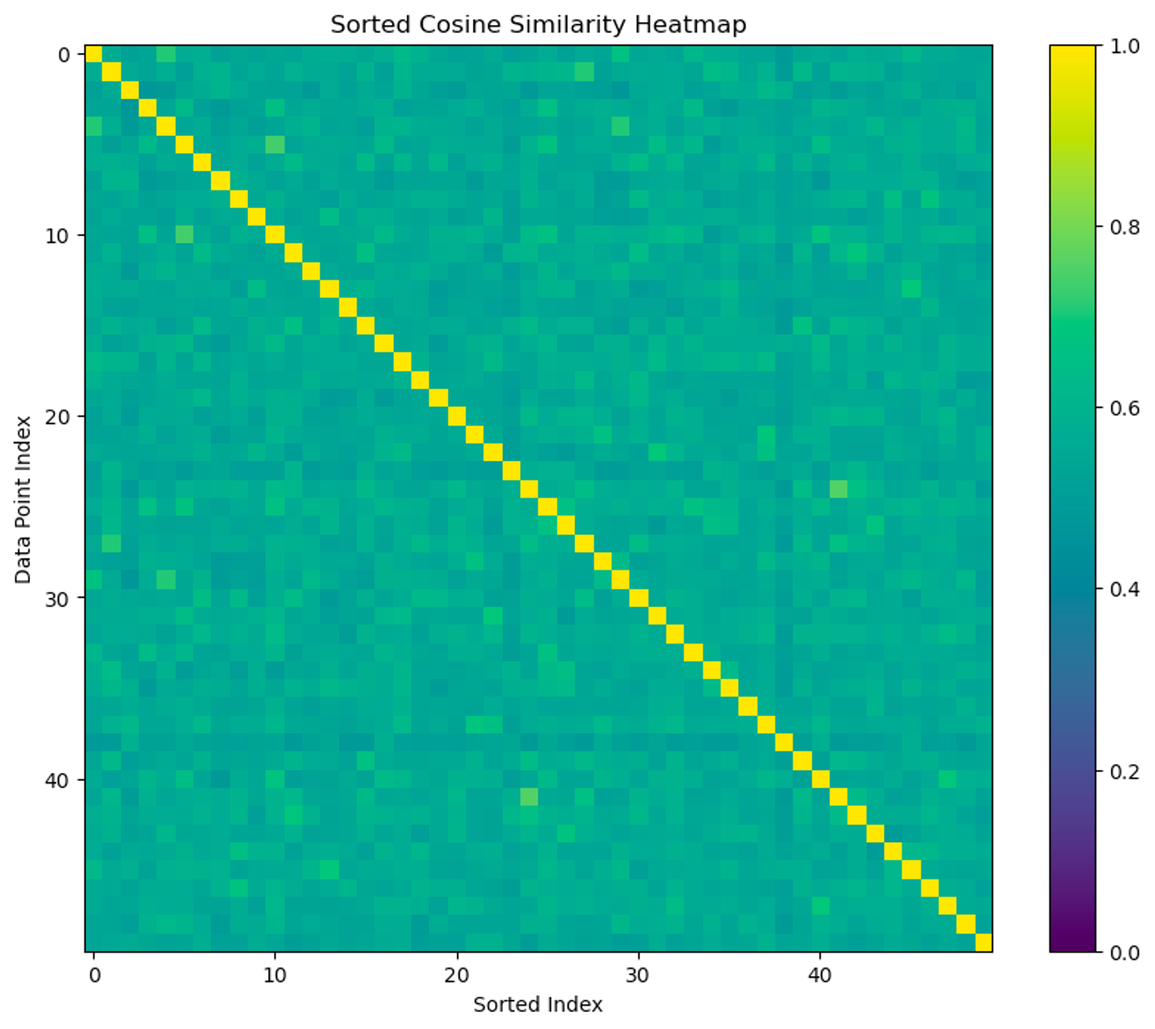
Themes
The impact of automation on legal industry
Exploring the future of food production and agriculture
The fusion of art and science
Enhancing access to quality mental healthcare in low-resource settings
Mental health and self-care practices
Nurturing innovation and creativity in the film and entertainment industry
Ave cos sim | 0.560238
# of themes | 0.035985

Slide 34
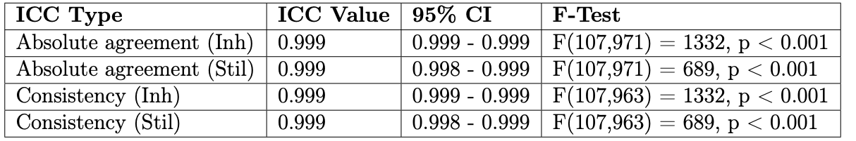
Consistency in Evaluation by GPT-4
Consistent evaluation of responses of similar quality is possible.＊
＊ ”Is GPT-4 a reliable rater? Evaluating Consistency in GPT-4 Text Ratings", Hackl, V. et al (2023)

Slide 35
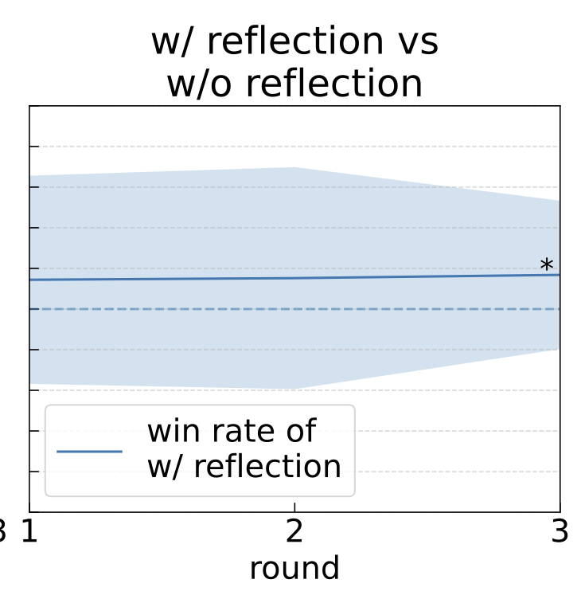
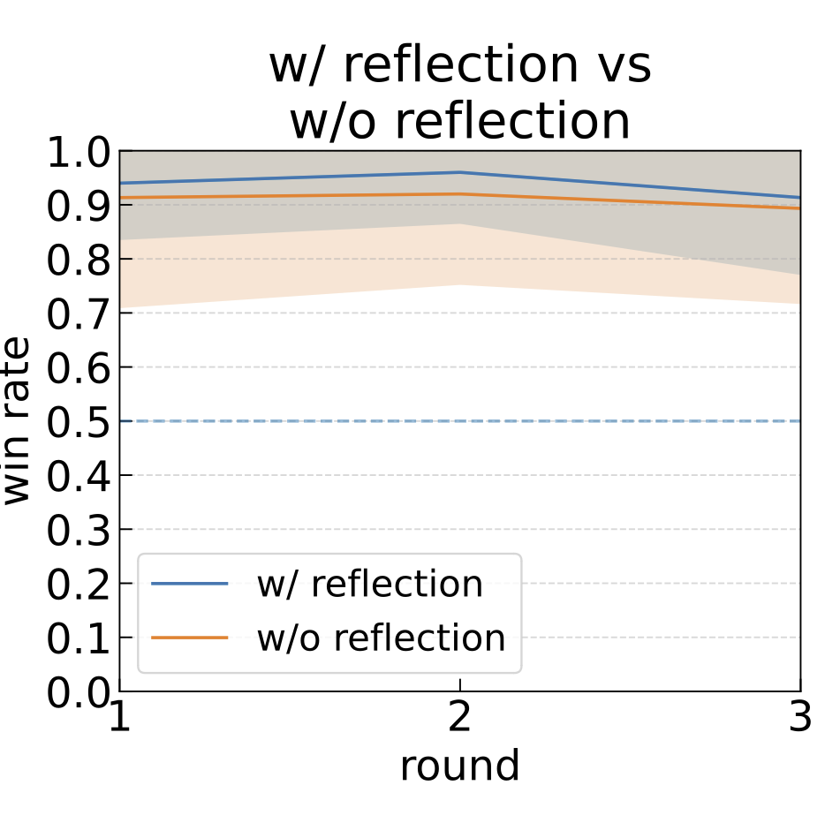
Reflection
実験・評価
# of comparisons | 750
# of themes | 50
Win rate of w/ reflection | 58.4±18.3% ( p < 0.05 )
# of themes (win rate >50%) | 34 (68.0% )

Slide 36
評価で利用された形容詞
adjectives | # of projects
unique | 53
comprehensive | 52
innovative | 51
impactful | 51
creative | 47
novel | 40
adjectives | # of Eval
comprehensive | 2520
sustainable | 2189
innovative | 1624
mental | 1509
unique | 1385
engaging | 1257

Slide 37
Simple(w/o role) vs Simple(w/ role)
Simply assigning roles has little impact on the creativity of generated ideas.
# of comparisons | 471
# of themes | 96
Win rates of w/ role | 55.1±30.2% ( p > 0.05 )
# of themes(win rate > 50%) | 57 (59.4% )

Slide 38
SPARK-flow Prompts：Opinion Generation
Opinion Generation
We are discussing to generate interesting ideas about the theme 'Innovative approaches to tackle climate change and environmental issues'.
Please list interesting ideas and opinions in bullet points from the perspective of the role 'Scientists' regarding other agents' views

Slide 39
SPARK-flow Prompts：PreMindMap Generation
We are discussing to generate interesting ideas about the theme 'Innovative approaches to tackle climate change and environmental issues'.
Below is a new opinions from the perspective of 'Scientists'
```
RawOpinion
```
Please group the opinions in the following format
# Grouping Format
- <Common points of Elements 1, 2...>
- <Element 1>
- <Element 2>
...
...

Slide 40
SPARK-flow Prompts：Reflection
We are discussing to generate interesting ideas about the theme 'Innovative approaches to tackle climate change and environmental issues'.
Below is a summary of the discussion content
PreMindMap
Please evaluate the ideas in this mindmap based on the criteria 'Feasibility, Impact, Scalability' and determine their priority
# Evaluation Format
- <Element>: Feasibility [High/Medium/Low] Impact [High/Medium/Low] Scalability [High/Medium/Low]...

Slide 41
SPARK-flow Prompts：Idea Generation
Combine the selected elements to generate idea about the theme of 'Innovative approaches to tackle climate change and environmental issues'.
```
Idea: <Idea Title>
Description: <Provide a brief summary in 2-3 sentences explaining the nature of the idea, its background, and why it is compelling.>
```

Slide 42
SPARK-flow Prompts：Idea Evaluation（GPT-4)
Which of the following ideas does a better job of capturing the essence of an '{theme}' while remaining unique and engaging?
An excellent idea should be both imaginative and relevant to the theme.
Theme: {theme}
Idea A: {idea_a}: {description_a}
Idea B: {idea_b}: {description_b}
FIRST provide a one-sentence comparison of the two ideas, explaining which you prefer and why.
SECOND, on a new line, state only "A" or "B" to indicate your choice. Your response should use the format: Preferred: <"A" or "B"

Slide 43
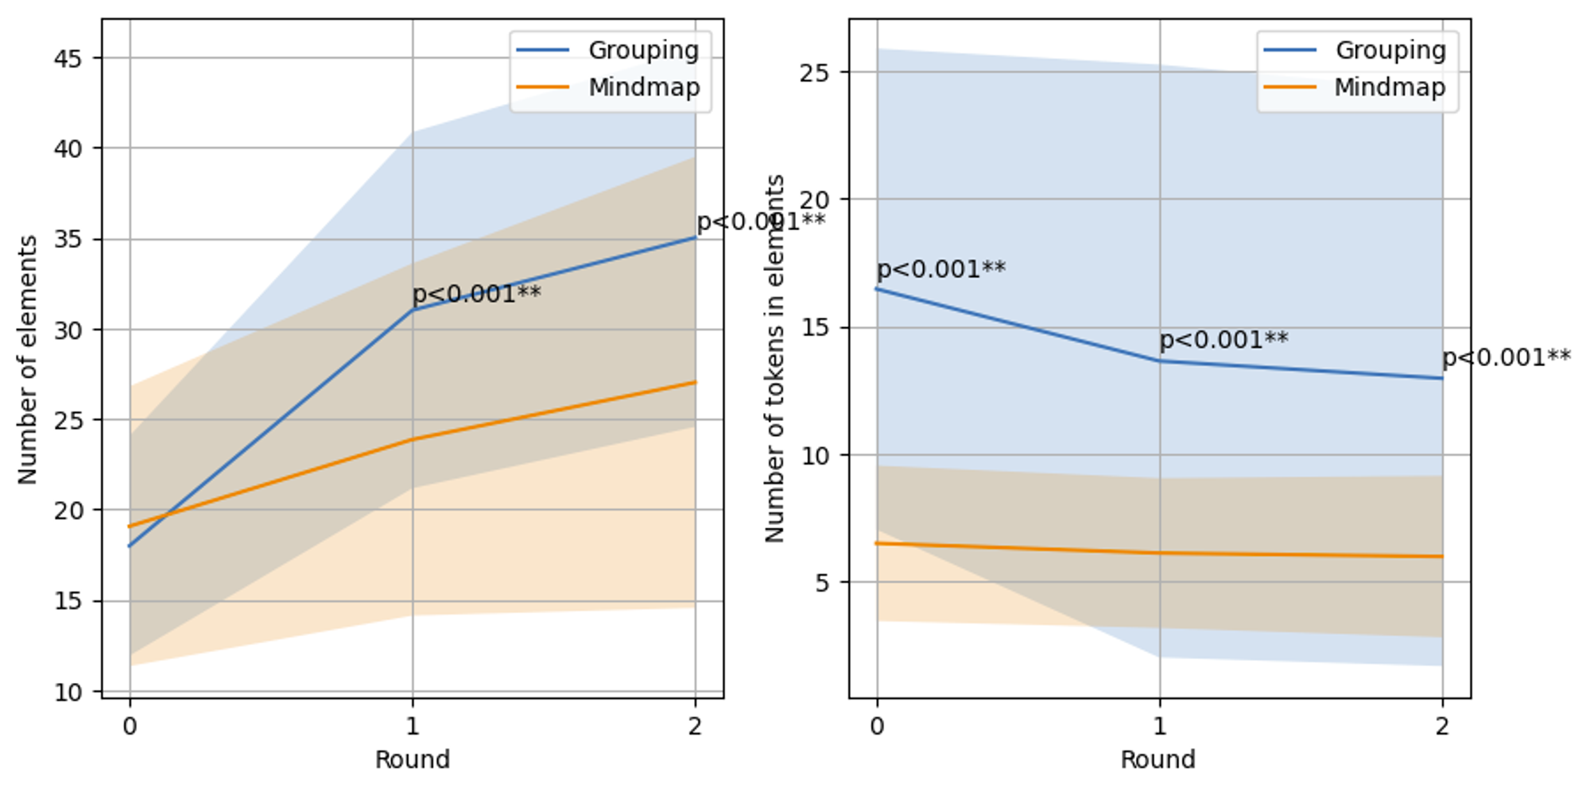
Comparison of Element and Token Counts between Mind Maps and PreMindMap
# of Elements
# of Tokens

